Slide 1

SMOKE DETECTION
PROJECT ON
GUIDED BY: NARESH KUMAR

Slide 2
TEAM MEMBERS
NAME: HTNO:
G VAMSHI 2103A51403
L VIGNESH 2103A51271
P SATHWIK 2103A51490

Slide 3
PROBLEM STATEMENT
The main objective of this project is to detect the presence of smoke in an environment using Artificial Intelligence and Machine Learning. The project aims to develop an intelligent smoke detection system that can be deployed in different environments, including indoor and outdoor spaces. The proposed system will use various sensors, including temperature and humidity sensors, to detect the presence of smoke in the environment.

Slide 4
EXISTING SYSTEM
1.Smoke detection using image processing:
This system uses image processing techniques to detect smoke in video streams. Machine learning models such as convolutional neural networks (CNNs) can be trained to classify images as containing smoke or not.
2.Smoke detection using audio analysis:
This system uses audio processing techniques to analyze the sounds of smoke alarms and other sounds in the environment. Machine learning models can be trained to recognize the specific sound patterns of smoke alarms and differentiate them from other sounds.
3.Smoke detection using wireless sensor networks:
This system uses a network of wireless sensors to detect smoke in indoor environments. Machine learning models can be trained to analyze the sensor data and detect patterns that indicate the presence of smoke.

Slide 5
PROPOSED SYSTEM
Smoke detection using environmental sensors:
This system collects data from environmental sensors such as temperature, humidity, and air quality sensors. Machine learning models can be trained to detect patterns in the sensor data that are indicative of smoke

Slide 6
OBJECTIVES
The objectives of smoke detection in machine learning can be defined as follows:
Temperature and humidity monitoring:
Air quality monitoring:
Fire detection:
Real-time monitoring:

Slide 7
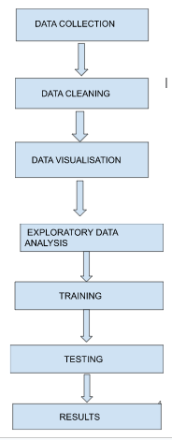
OVERALL ARCHITECTURE

Slide 8
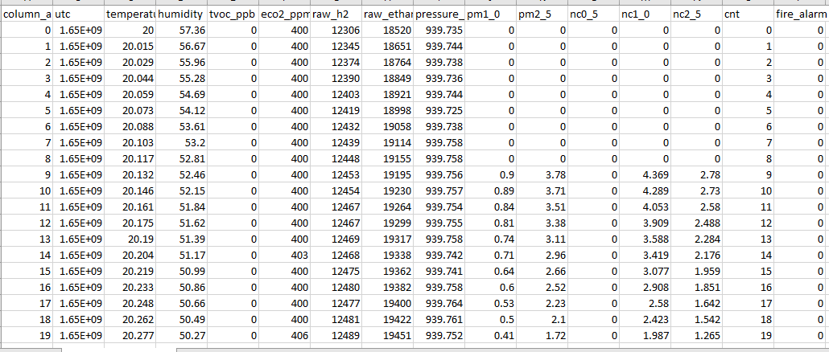
DATASET
Make Effective Presentations
Using Awesome Backgrounds
Engage your Audience
Capture Audience Attention

Slide 9
DESCRIBE DATASET
UTC: A variable that contains the time stamp for each observation.
Temperature[C]: A continuous variable that contains the temperature readings in degrees Celsius.
Humidity[%]: A continuous variable that contains the humidity readings as a percentage.
TVOC[ppb]: A continuous variable that contains the total volatile organic compounds readings in parts per billion.
eCO2[ppm]: A continuous variable that contains the equivalent CO2 readings in parts per million.
Raw H2: A continuous variable that contains the raw hydrogen sensor readings.
Raw Ethanol: A continuous variable that contains the raw ethanol sensor readings.
Pressure[hPa]: A continuous variable that contains the pressure readings in hectopascals.
PM1.0: A continuous variable that contains the readings for particles with a diameter of 1.0 micrometers or smaller.

Slide 10
DESCRIBE DATASET
10. PM2.5: A continuous variable that contains the readings for particles with a diameter of 2.5 micrometers or smaller.
11. NC0.5: A continuous variable that contains the number concentration readings for particles with a diameter of 0.5 micrometers or smaller.
12. NC1.0: A continuous variable that contains the number concentration readings for particles with a diameter of 1.0 micrometers or smaller.
13. NC2.5: A continuous variable that contains the number concentration readings for particles with a diameter of 2.5 micrometers or smaller.
14. CNT: A continuous variable that contains the particle count readings.
15. Fire Alarm: A categorical variable that indicates the presence of a fire alarm (1) or not (0).

Slide 11
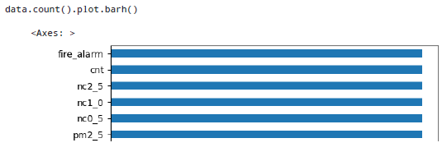
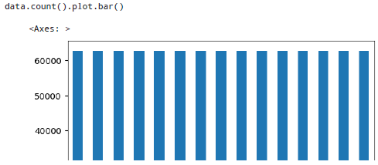
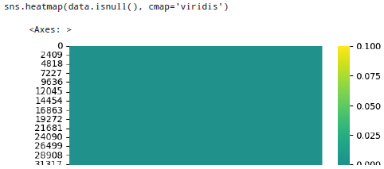
Data visualization

Slide 12
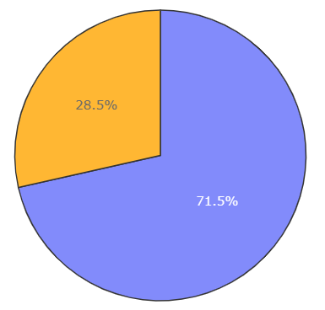
Data visualization
The Pie chart represents the distribution of the 'fire_alarm' variable in the 'data' dataframe.
The 'labels' parameter in the function contains two values - 'Yes_Fire' and 'No_Fire', which are the labels for the two slices of the Pie chart. The 'values' parameter contains the count of 'fire_alarm' values that are 'Yes_Fire' and 'No_Fire' respectively.

Slide 13
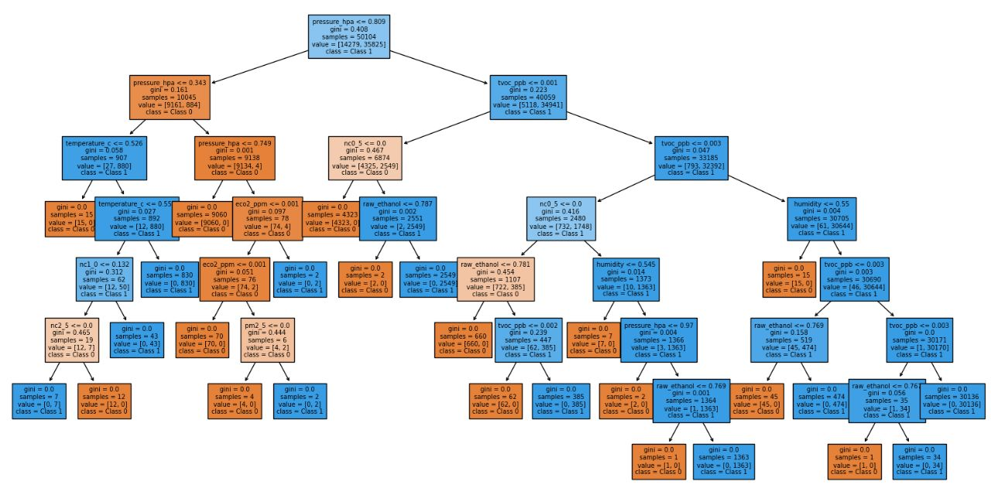
Model architecture

Slide 14
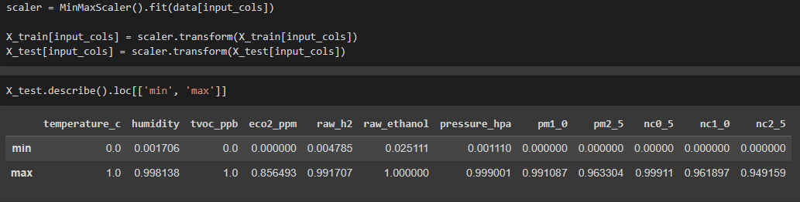
DATA NORMALIZATION

Slide 15
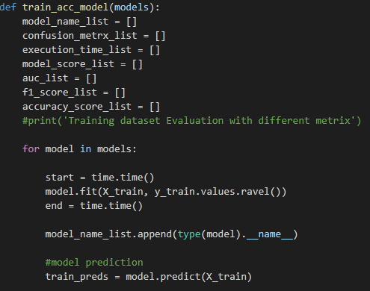
TRAINING MODEL

Slide 16
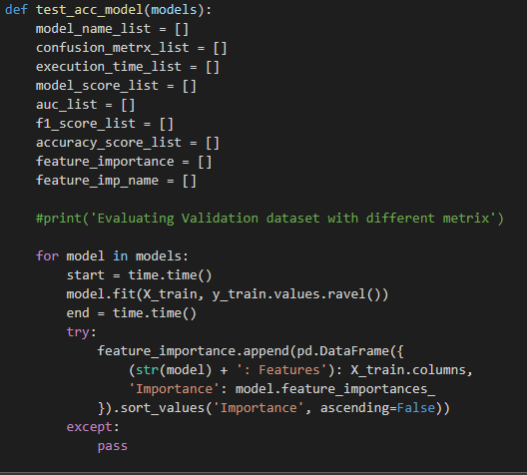
TESTING MODEL

Slide 17
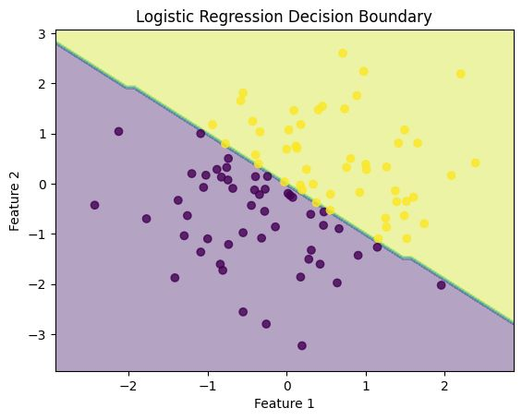
RESULTS
The graph shows the decision boundary of a logistic regression model on a 2-dimensional dataset. The decision boundary is the line that separates the regions where the model predicts different classes. In this case, the model predicts two classes, represented by different colors in the graph.

Slide 18
CONCLUSION
we have successfully performed exploratory data analysis on the Smoke Dataset. We were able to identify the important features that contribute to the accuracy of our models. We also trained and tested five different models and obtained a high accuracy rate for all the models for Logistic Regression. Overall, we can confidently make predictions on new data using any of the models selected.

Slide 19
REFERENCES
https://medium.com/inside-machine-learning
https://data.world/adam1125/smokedetection/workspace/file?filename=smoke_detection.csv

Slide 20
THANK YOU

